Slide 1
Path Planning with the humanoid robot iCub
Semester Project 2008
Pantelis Zotos
Supervisor: Sarah Degallier

Slide 2
Overview of the presentation
What is Path Planning?
Ant Colony Optimization
Performance Tests – Parameters selection
iCub robot – Steering
Integration of the ACO algorithm in the iCub simulation
Results
Future Improvements

Slide 3
What is Path Planning?
Examine of the existence of a collision-free path in an environment with obstacles
Computation of such a path
Efficiency : to find the shortest path to the destination in short time.
Reliability : the robot must not collide with obstacles.

Slide 4
Overview of the presentation
What is Path Planning?
Ant Colony Optimization
Performance Tests – Parameters selection
iCub robot – Steering
Integration of the ACO algorithm in the iCub simulation
Results
Future Improvements

Slide 5
Ant Colony Optimization (1)
Biological inspiration: many ant species deposit on the ground a substance, called pheromone, on their way to the food. Other ants follow the path with the highest concentration in pheromone…
They will find a solution in any case, if it exists. Theoretical proof of the convergence to the optimal solution (Gutjahr 2000).

Slide 6
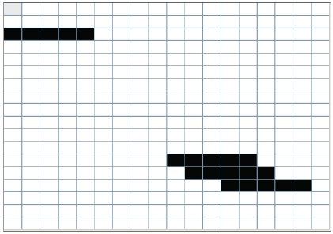
Ant Colony Optimization (2)
Heuristic function: ACO algorithm is able to take advantage of the specific characteristics of a problem by using a well defined heuristic function.
In our implementation: the world considered as a grid of squares.
A set of artificial ants search for a short path from the start to the end.

Slide 7
Ant Colony Optimization (3)
Each agent has a current position in the grid, can move by one square, 7 possible new positions.
At each step, random decision according to a probability distribution.
After all ants have found a solution, the shortest path is selected and is updated with pheromone.
Continue until no more improvement is happening or until a fixed number of iterations (generations).

Slide 8
Overview of the presentation
What is Path Planning?
Ant Colony Optimization
Performance Tests – Parameters selection
iCub robot – Steering
Integration of the ACO algorithm in the iCub simulation
Results
Future Improvements

Slide 9
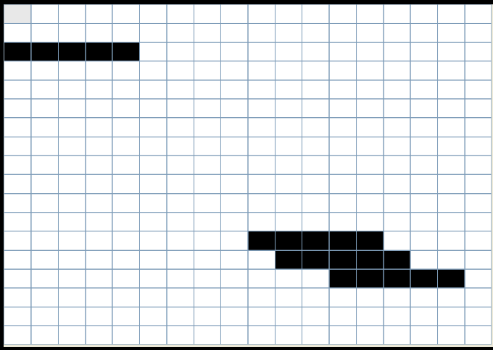
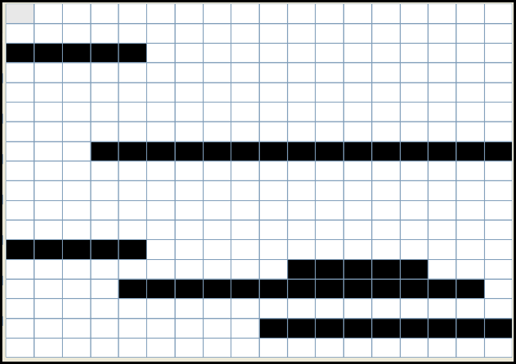
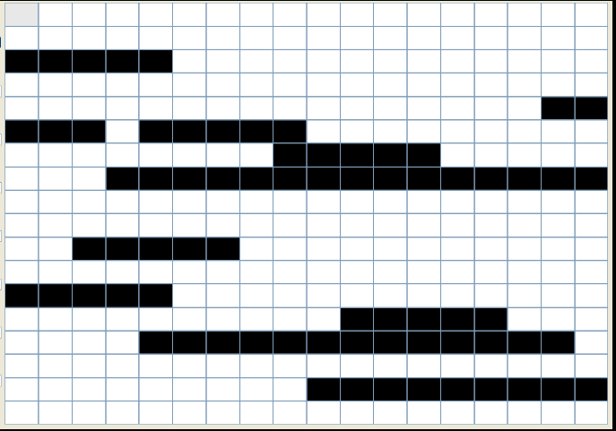
Performance Tests – Parameters selection (1)
Heuristic function used:
Parameters to select:
Number of ants
Number of generations
α , the pheromone factor
β , the heuristic factor
3 different environments (18x18)

Slide 10
Performance Tests – Parameters selection (2)
1st environment. Increasing number of ants.
10 executions for each set of parameters. Average solution length
The variance of the found solutions decreases as the number of ants increases.
Stabilization after 100 ants.

Slide 11
Performance Tests – Parameters selection (3)
2nd environment. 20 and 100 ants. Increasing number of generations.
For 100 ants, stabilization after about 100 generations.

Slide 12
Performance Tests – Parameters selection (4)
2nd environment.100 ants. Increasing number of generations.
Comparison of average solution and best of 10 executions.

Slide 13
Performance Tests – Parameters selection (5)
3rd environment. Different combinations of α and β. All combinations converge at about same quality solutions but in different number of generations. The pair α=2, β=1 was chosen.

Slide 14
Performance Tests – Parameters selection (6)
For large values of α (bigger than 1), the algorithm is expected to stagnate to the first good solution found.
If a very good heuristic is available we should use bigger values for β in order to take advantage of it.
Environments with random distribution of obstacles : difficult to find a very good heuristic for every kind of problem.
Parameters selected for the integration of the ACO algorithm to the iCub:
Number of ants = 100. α = 2, β=1.
Number of generations : time limit or fixed number.

Slide 15
Overview of the presentation
What is Path Planning?
Ant Colony Optimization
Performance Tests – Parameters selection
iCub robot – Steering
Integration of the ACO algorithm in the iCub simulation
Results
Future Improvements

Slide 16
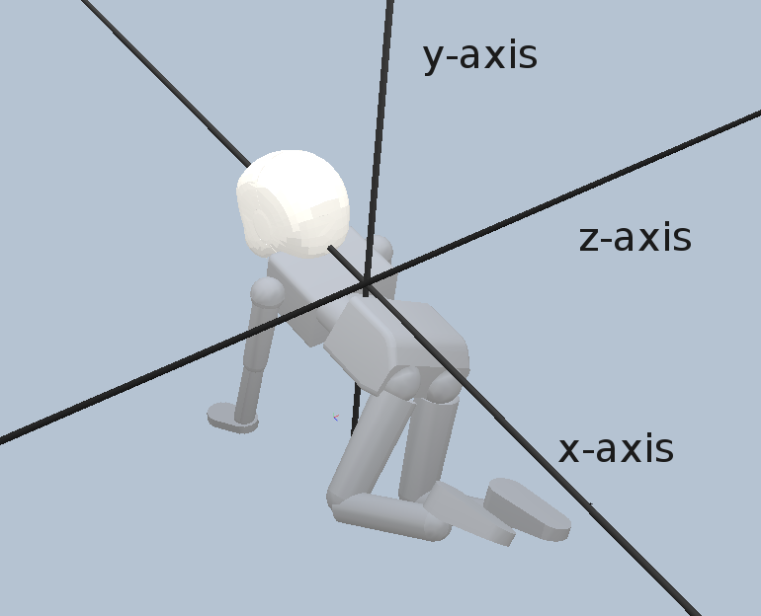
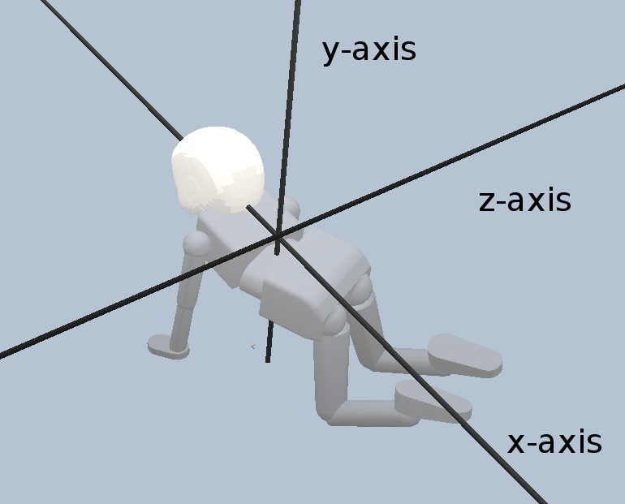
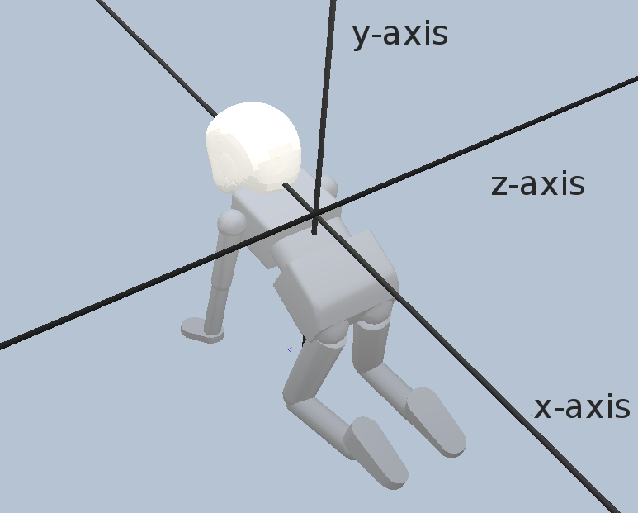
iCub robot – Steering (1)
iCub is an infant-like robot with the cognitive abilities of a 2 years-old child.
Its crawling is controlled by a CPG developed by Righetti (2006).
Add steering ability to iCub. Take advantage of the ability to turn its torso around 3 axises.

Slide 17
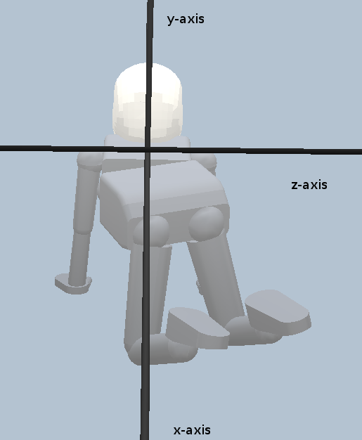
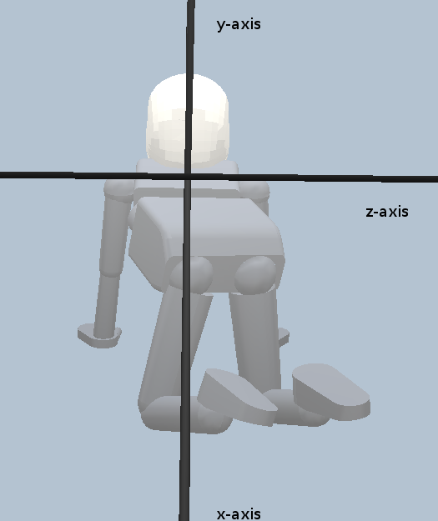
iCub robot – Steering (2)
Rotate around y-axis and x-axis.
The outer limbs have to make a bigger step than the inner ones during steering.
Very small changes at each step, such that the motion to be as smooth as possible.

Slide 18
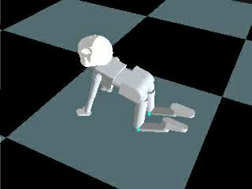
iCub robot – Steering (2)

Slide 19
Overview of the presentation
What is Path Planning?
Ant Colony Optimization
Performance Tests – Parameters selection
iCub robot – Steering
Integration of the ACO algorithm in the iCub simulation
Results
Future Improvements

Slide 20
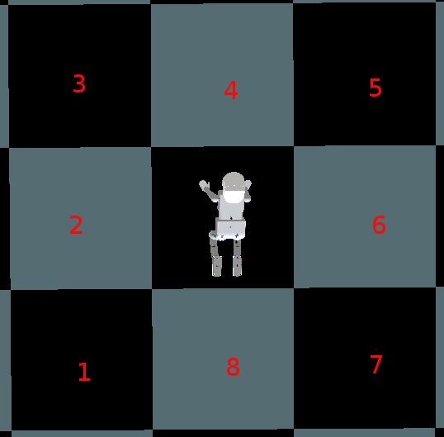
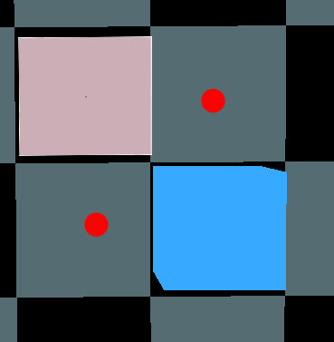
Integration of the ACO algorithm in the iCub simulation (1)
Board of 8x8 squares surrounded by a wall and with 5 square obstacles inside
4 modifications.
The robot is not able to steer in a very big angle.
a diagonal movement must not be valid if there are two obstacles adjacent to the robot's movement.

Slide 21
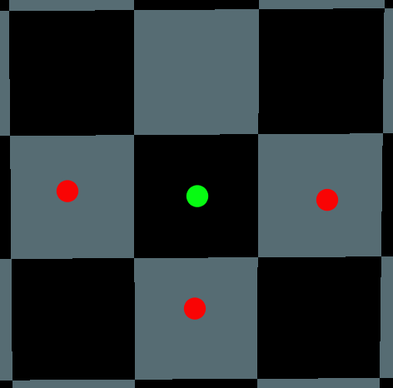
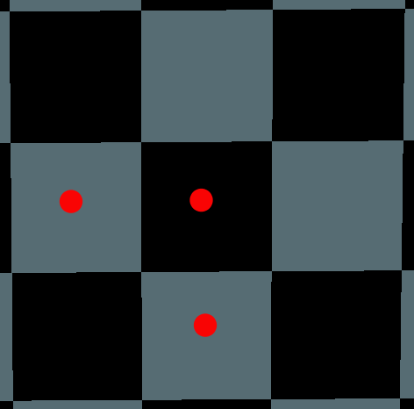
Integration of the ACO algorithm in the iCub simulation (2)
4 modifications.
The robot prefers to move straight instead of steering.
The robot prefers to move diagonally instead of making a 90º turn.
The obstacles can change their position dynamically.

Slide 22
Overview of the presentation
What is Path Planning?
Ant Colony Optimization
Performance Tests – Parameters selection
iCub robot – Steering
Integration of the ACO algorithm in the iCub simulation
Results
Future Improvements

Slide 23
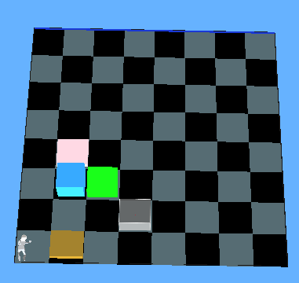
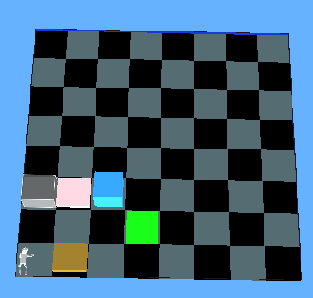
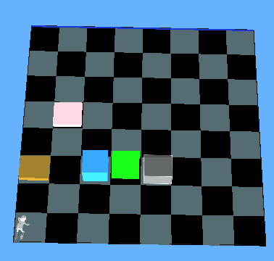
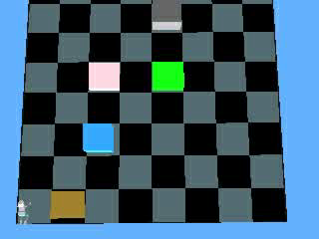
Results
Grids, in which the iCub successfully reached the goal position.
Example of dynamically changed environment. The robot recomputes its plan to the goal position, when it detects a change in the positions of the obstacles.

Slide 24
Overview of the presentation
What is Path Planning?
Ant Colony Optimization
Performance Tests – Parameters selection
iCub robot – Steering
Integration of the ACO algorithm in the iCub simulation
Results
Future Improvements

Slide 25
Future Improvements
Recomputation of the robot's path to the goal position during the simulation, for instance after every 5 steps.
Multiple executions of the algorithm and selection of the shortest path.
Ability to detect if iCub is following a wrong route.
Integration of the ACO algorithm in the real iCub robot and test of its performance in real environment conditions.

Slide 26
Questions

